Slide 1
3D Motion ControlLer
RedSox: Anundson, Chen, Ghosh, Lin, Yang

Slide 2
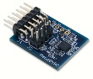
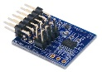
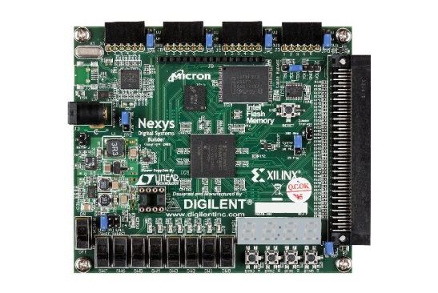
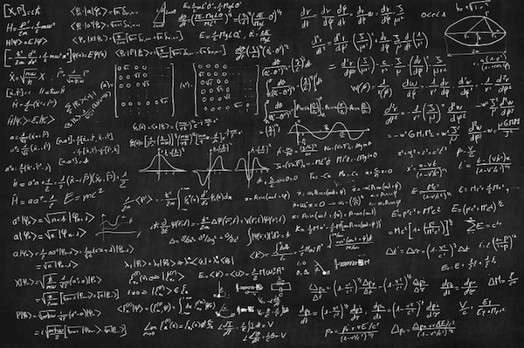
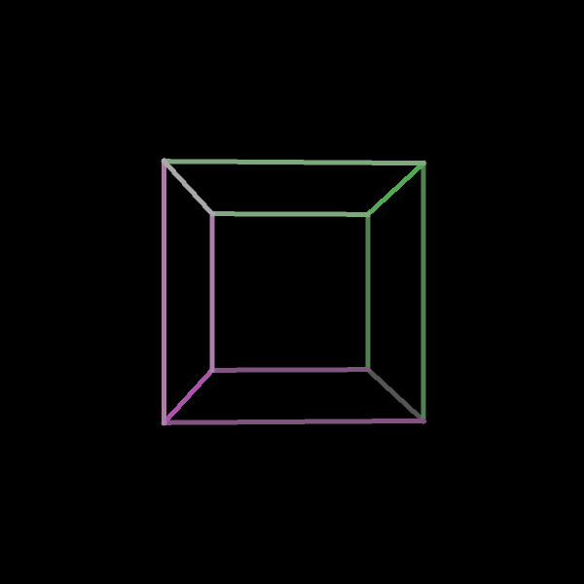
Concept
Notes:
Concept in a nutshell: Manipulation of a sensor board to realistically render an image and its transitions on screen
Rig an FPGA with sensors
Do some math
Realistically render a 3D image and its transitions on screen

Slide 3
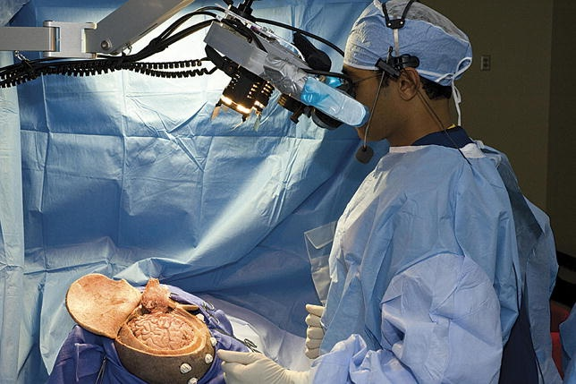
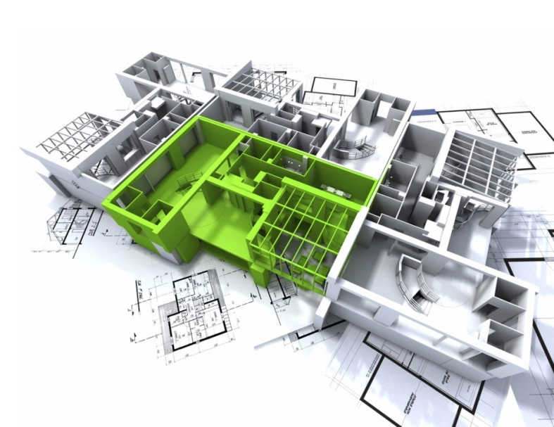
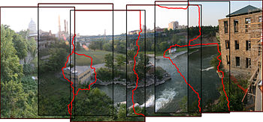
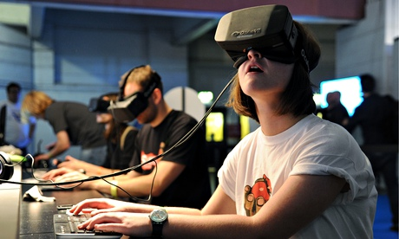
Goal and Motivation
Notes:
Gesture based control combined with 3D has many cool and interesting applications
Interactive 3D models
Immersive video game
Image processing and stitching
Render 3D environment from images and motion data

Slide 4
Specification and Functionality
Gesture capture
Interface with gyro and accelerometer via SPI interface
Interpret data from the gyro and accelerometer to be used to control different demo components
Basic control using raw gyro or accelerometer data
Filter and combine accelerometer and gyro data into a set of orientation coordinates
2D maze to demonstrate gesture control
Display maze
Implement collision detection
Simple 3D rendering
Draw a line on a VGA display between two arbitrary points
Calculate 2D translations of corners of a cube moving in a 3D space

Slide 5
High-Level Design 1
FPGA Design
Gyro
SPI Interface
Orientation Calculations
orientation
Accelerometer
SPI Interface
acceleration
VGA Monitor
VGA Driver
Rocking ball demo
Mode Select
Maze
Switches
Notes:
Since our project is split up into 3 demos, we decided to combine demos 1 and 2 onto 1 design, and demo 3 on its own design.
Here is the FPGA design for demo 1 (rocking ball) and demo 2 (2D Maze)

Slide 6
High-Level Design 2
FPGA Design
Gyro
SPI Interface
Orientation Calculations
orientation
Accelerometer
SPI Interface
acceleration
VGA Monitor
VGA Driver
Wireframe cube demo
Notes:
Here is the FPGA design for demo 3 (3D wireframe cube)

Slide 7
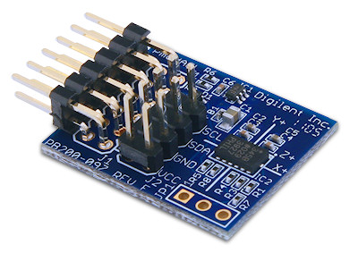
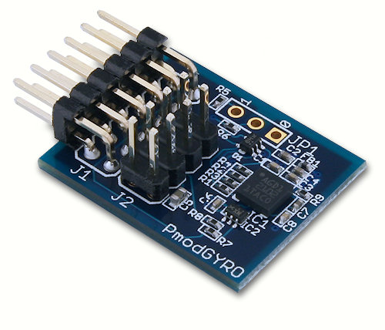
Gyro and Accelerometer Interfacing Pt 1
Task 1: Interface with gyro and accelerometer via SPI
LL, TY
Notes:
Interfacing with the gyro and accelerometer: This is the first functional spec of our project. The first task of this spec is to interface with the gyro and accelerometer via the SPI interface protocol

Slide 8
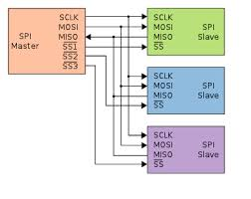
Gyro and Accelerometer Interfacing Pt 1
SPI
Master-slave
Master generates clock signal
Master to slave via MOSI
Slave to master via MISO (Full duplex)
Slave select to “wake up” slave
LL, TY
Notes:
Explanation of how SPI works

Slide 9
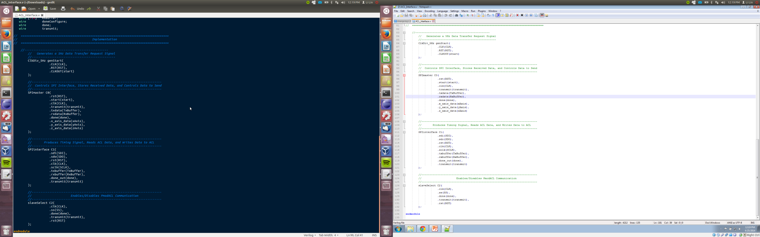
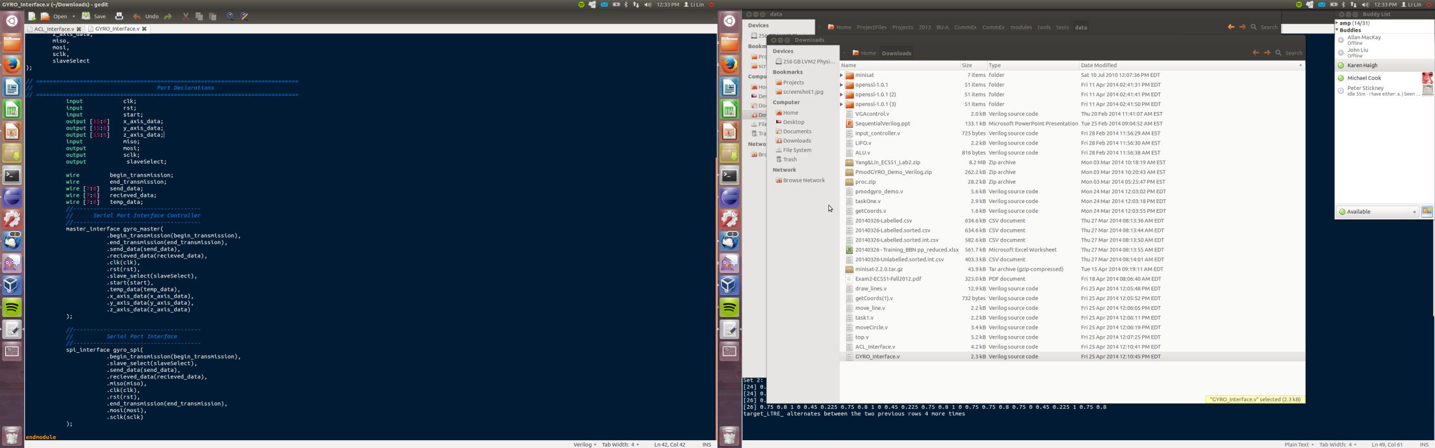
ACL Interfacing
GYRO Interfacing
LL, TY
Notes:
Pointing out the modules that implement the SPI interface
Master module
SPI interface module
Slave module
9

Slide 10
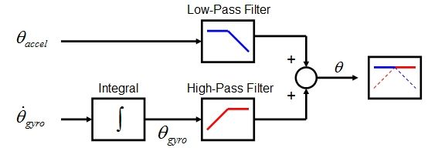
Gyro and Accelerometer Interfacing Pt 2
Task 2: Combine gyro and accelerometer data into orientation using a complementary filter
http://www.instructables.com/id/PCB-Quadrotor-Brushless/step15/IMU-Part-2-Complementary-Filter/
TY
Notes:
Complementary filter high-pass gyro data and low pass accelerometer data.
Gyro:the measurement has the tendency to drift, not returning to zero when the it went back to its original position. The gyroscope data is reliable only on the short term, as it starts to drift on the long term.

Slide 11
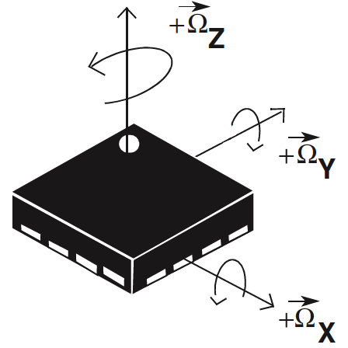
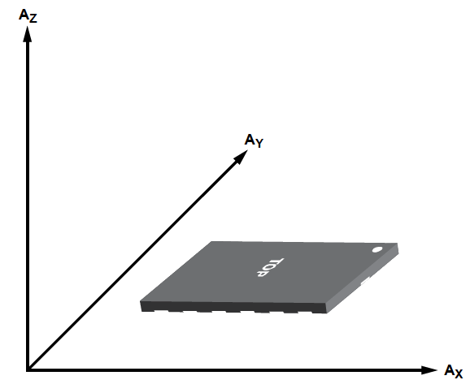
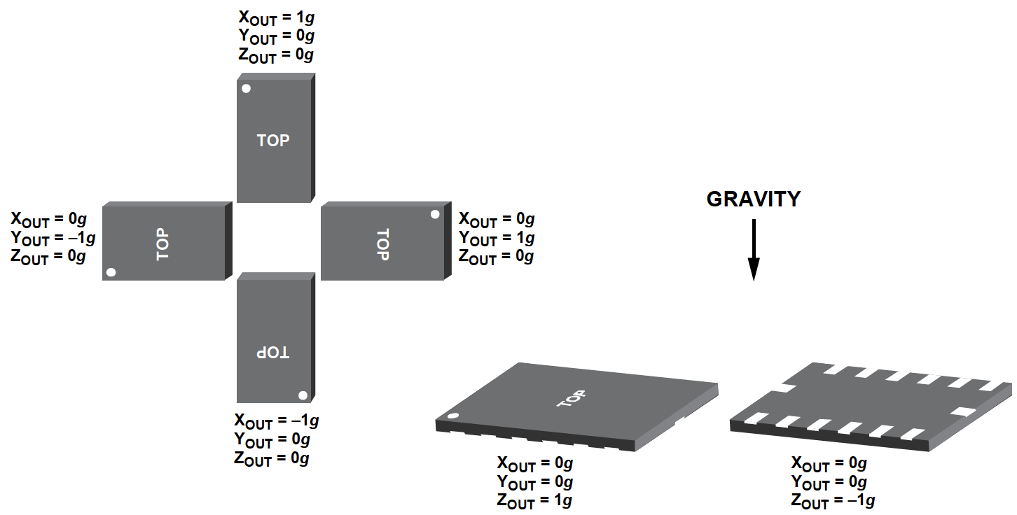
Gyro and Accelerometer Interfacing Pt 2
LL, TY
Notes:
Gyro measures the angular velocity around xyz axis.
Accelerometer measures axis’s gravity, it gives out the vector projection on gravity.

Slide 12
Gyro and Accelerometer Interfacing Pt 2
Gyroscope
Accelerometer
SPI Interface
SPI Interface
SPI Interface Controller
SPI Interface Controller
16-bit xyz gyro data
angular velocity
10-bit xyz acc data
gravity projection
CompFilter
acc_degree←arctan(acc_x, acc_y)
gyro_degree ← gyro_degree+∫ gyro_data data*dt
E.g. x_degree=0.98*x_gyro+0.02*x_acc
16-bit xyz orientation data
TY
Notes:
The angular velocity coming from gyro is integrated over time to get degree value and constantly added to itself.
The gravity data coming from accelerometer feeds to an arctan2 CORDIC core and spit out the degree value.
The two results are combined together with a high-pass gyro and low-pass accelerometer complimentary filter.

Slide 13
Arbitrary Line Drawing
Bresenham’s line algorithm
Calculates which pixels to illuminate between two points
Can be implemented using integer math
Dual port RAM used as VGA display buffer
Utilizes the BRAM resources in the FGPA
Module uses FIFOs to store multiple sets of line coordinates to be drawn for each screen refresh
KA

Slide 14
Arbitrary Line Drawing
x0_coord
FIFO
Display State Machine
x1_coord
FIFO
y0_coord
FIFO
Bresenham
Clear Buffer
y1_coord
FIFO
refresh screen
hcounter
VGA Display Logic
VGA Buffer
vcounter
pixel_on
KA
Notes:
Bresenham algorithm is core of line drawing module. Chooses which pixels to display.
Display state machine controls process of: clearing screen buffer, loading line points from FIFOs and writing line pixels to VGA buffer.
VGA display logic tells whether a pixel defined by hcounter and vcounter is on.

Slide 15
Arbitrary Line Drawing
Algorithm works very well for a hardware application
Integer math
Simple state machine
Trade-offs
Uses a large buffer to store screen buffer
Design successfully implements line drawing at 640x480 resolution
Consumes a large amount of area
Can only store “on” or “off” so cannot store different color lines
Possible alternatives for future development
Use a larger FPGA device
Use off-chip memory to store screen buffer
KA

Slide 16
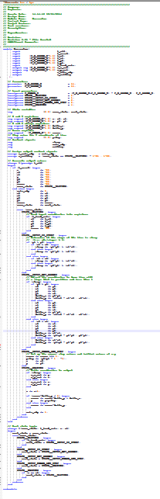
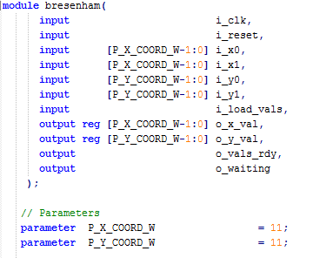
Verilog Example: Bresenham
KA
Notes:
Inputs and outputs:
Clock and reset
Input points (x0,y0) and (x1,y1)
Load vals strobe initiates bresenham state machine and move it out of waiting state
Output points (x_val, y_val)
Vals_rdy flag indicates if the output values are valid
Waiting flag to indicate that the bresenham module can accept a new line to process
Parameters for widths of x and y coordinates

Slide 17
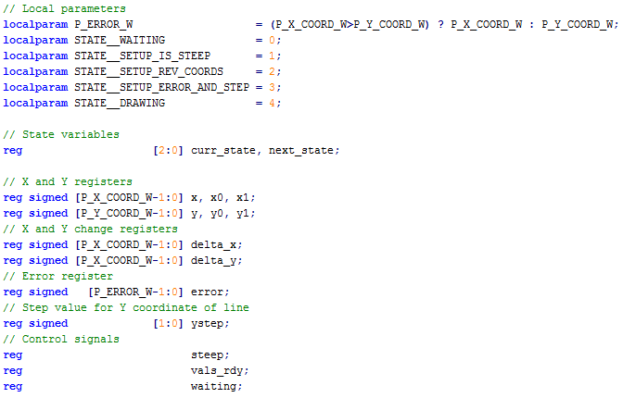
Verilog Example: Bresenham
KA
Notes:
Local parameters to define width of error and define state names
Registers for state registers, local storage of x and y coordinates for processing, registers for output flags

Slide 18
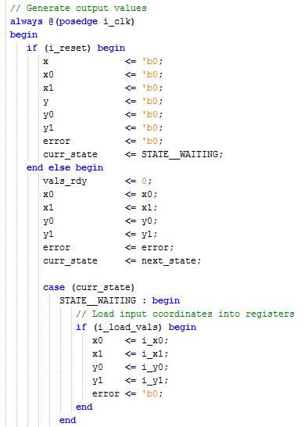
Verilog Example: Bresenham
KA
Notes:
Synchronous reset (reset current state and calculation values)
Assign default values, could be overridden by case statement
Waiting state: on load_vals strobe, load coordinates to internal registers

Slide 19
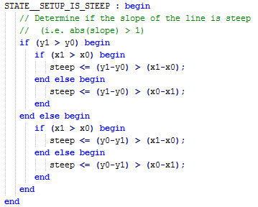
Verilog Example: Bresenham
KA
Notes:
Determine if the line is “steep” i.e. if the magnitude of the slope is greater than 1

Slide 20
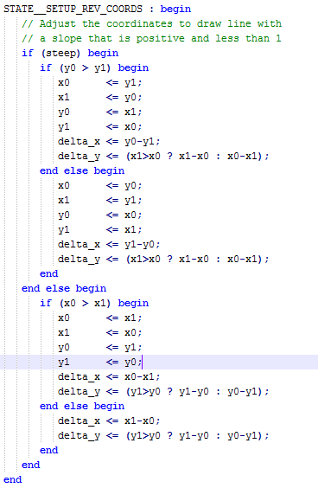
Verilog Example: Bresenham
KA
Notes:
Determine if coordinates need to be swapped if slope is negative and/or steep
Take advantage of previously determined is_steep value

Slide 21
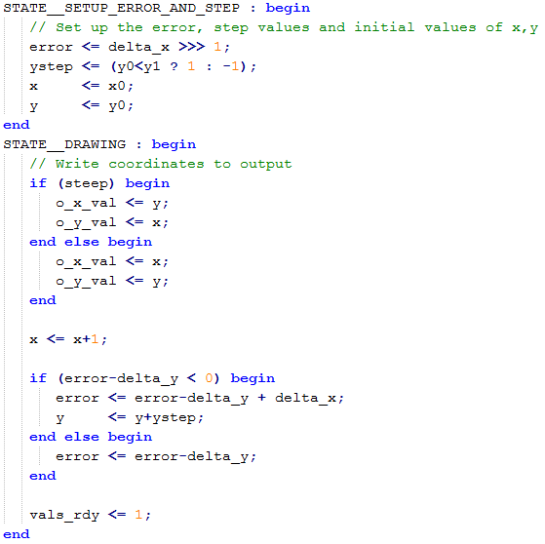
Verilog Example: Bresenham
KA
Notes:
Setup initial step and error values and intitialize x and y values used by drawing state
Draw pixel: if steep, swap x and y
increment x
calculate new error and (possibly) increment y based on error-delta_y
Repeat drawing step until reaching the end of the line

Slide 22
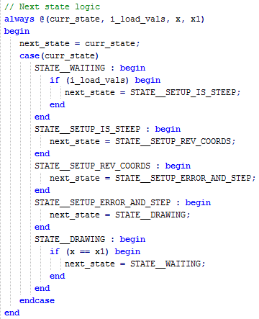
Verilog Example: Bresenham
KA
Notes:
Next state logic
Only states that are conditional are the waiting and drawing states

Slide 23
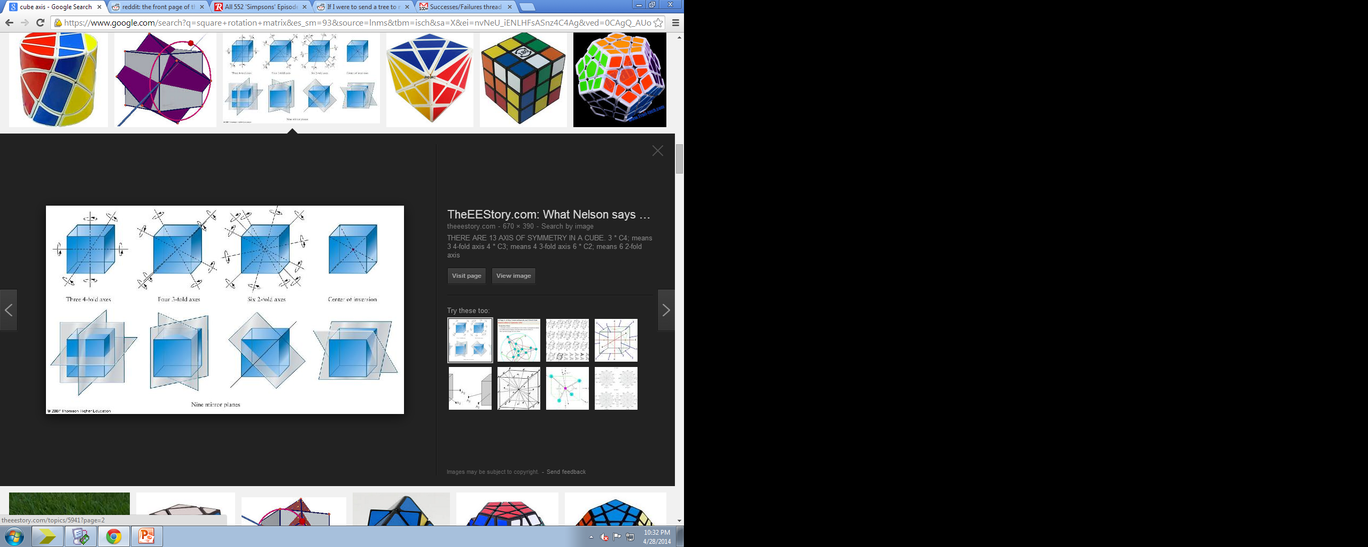
Wireframe Cube Display
Functionality
Uses Gyro And Accelerometer Data as input to manipulate 3D cube size and position
Continually update display screen with image of cube
Simulate matrix multiplication calculations for cube rotations in 3D space
Values are pushed into line drawing buffer
Use 4 fold axis rotation over
3 or 2 fold rotation due to simplified
calculation
KC

Slide 24
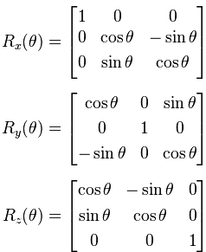
Wireframe Cube Display
Gyro
Matrix Multiplication
broken down through incremental calculations cycles
Sin & Cosine lookup table
Cos & Sin of X,Y,Z
Accelerometer
Clock
Cube Start Coordinates
1 of 12 lines
Draw Line Module
Output Modified Coordinates
KC

Slide 25
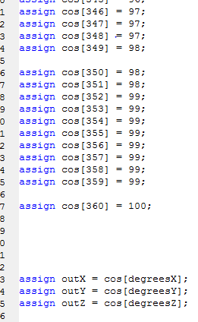
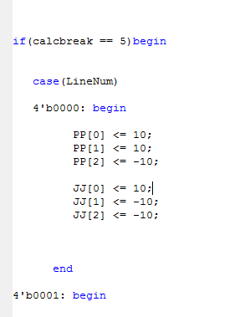
Wireframe Cube Display
Look up table for Values. The accuracy of values was limited to accuracy to the hundredth decimal place due to limits of the onboard memory
Insertion of Cube coordinates at starting position.
KC

Slide 26
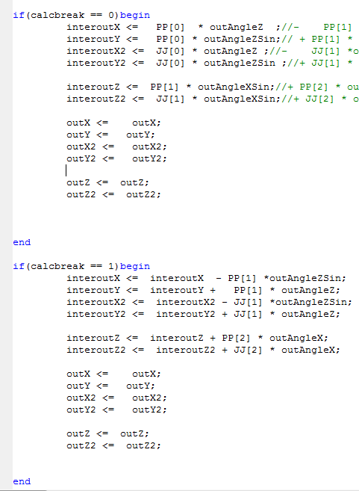
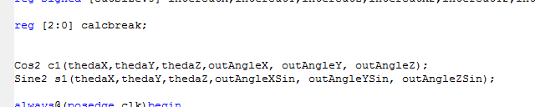
Wireframe Cube Display
Calculations are cascaded through a series of
Intermediate steps. This was put in due to
the limits of the FPGA. We could not squeeze in
All the calculations needed in one cycle due to
Limits in DSP48A1s Slices.
Outputs of the lookup table and coordinates are fed into the calculations
KC

Slide 27
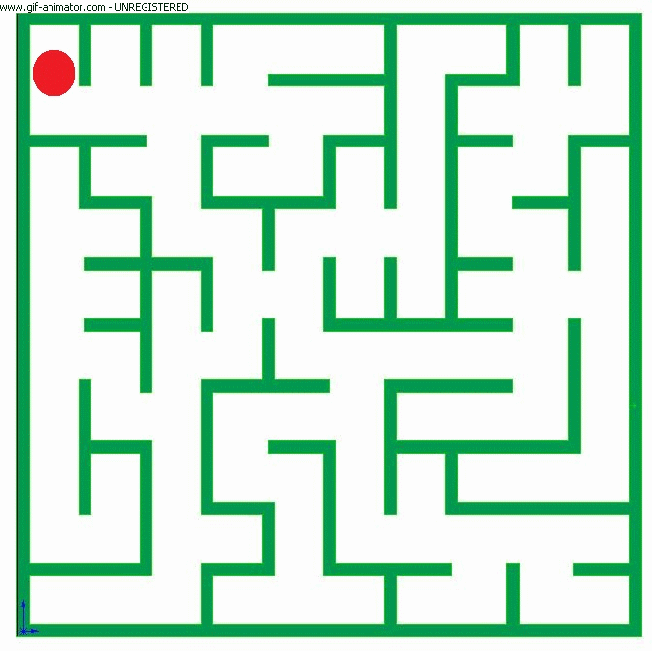
2D Maze
Functionality
Takes the data input from the gyro
The VGA_Display module converts
the data to the dimensions of the ball
that moves through the maze
A 2D maze is displayed on the VGA
Collision Detection is implemented by the inputs taken from the gyro
The aim of the game is to move the ball to the end of the maze
AG, KA, LL

Slide 28
2D Maze
Features of the Maze
A switch is provided which
when turned on enables the
maze to blink.
Different portions of the maze appear
at regular intervals hence making it
tougher for the ball to complete the game
The color of the maze keeps changing throughout the game giving it a visual appeal.
AG, KA, LL

Slide 29
2D Maze Game
Top
Gyro
Data Select
task3
Maze and Ball Logic
Accelerometer
Maze Portion Files
Switches
Ball Logic
SPI Component
Accelerometer
Cursor ROM (Baseball sprite)
VGA Monitor
VGA Controller
AG, KA, LL
32-bit xyz orientation data

Slide 30
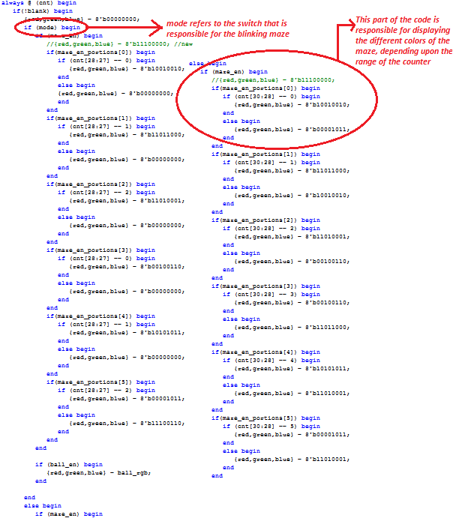
2D Maze Game
Verilog Code Snippet showing the Maze Display
AG, KA, LL

Slide 31
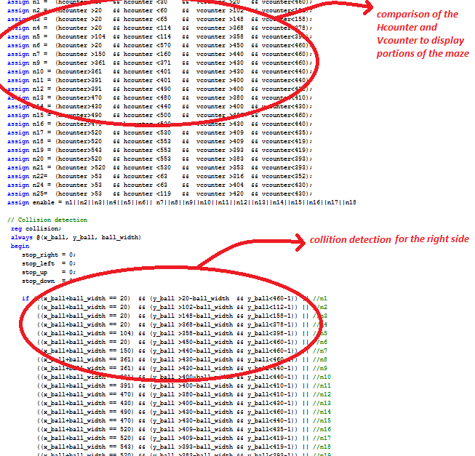
2D Maze Game
Verilog Code Showing Collision Detection
AG, KA, LL
Notes:
Abby

Slide 32
Project Reflections: Successes and Future Work Pt 1
Gyro + ACL Interfacing
Interfacing was relatively simple, since the SPI interface code was already written
Would have been nice to write SPI interface modules (Or some custom protocol..?)
Complimentary Filter
Data scaling is tricky
More accurate (expensive) pmod components would be better
Could write SPI interface ourselves and use wider sensing range
Line Drawing (Bresenham’s)
Might be nice to store screen buffer off-chip (Latency issues)
Possibly use larger FPGA so screen buffer does not consumer all BRAM resources

Slide 33
Project Reflections: Successes and Future Work Pt 2
2D Maze
Successfully integrating the Maze and the movement of the ball with the Gyro on one board.
Would have been better to have implemented the 3D Maze, although it requires more memory
Wireframe Cube
Memory and limits in calculation blocks were a constant ceiling we kept hitting. Need a beefier board.
Initial concept was to form a cube. But realized it would have been more interesting to draw insides of a room and used gyro to “look around” the room
Timing errors in calculations were not caught by the program and as a result gave a lot of misleading readings that required many hours of debugging
Notes:
2D Maze
Wireframe Cube

Slide 34
Questions?

